Slide 1
Self Service Desktops
Streamed desktops with Provisioning Services
Simon Waterhouse
June 2013

Slide 2
Introduction
Citrix Self Service Desktops provides a simple, easy to use solution for provisioning Windows desktops
Desktops are hosted in Citrix CloudPlatform 3.0.6
Published in Citrix XenDesktop 5.6 which brokers HDX connection
This presentation describes support for streamed desktop from Citrix Provisioning Services 6.1

Slide 3
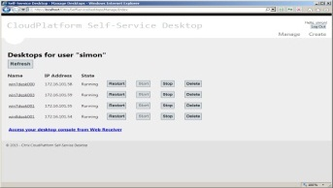
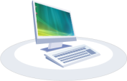
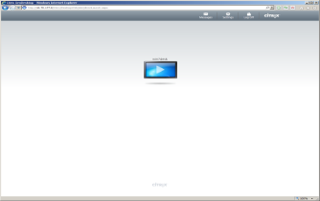
Architecture
Manage Desktops
Create & Manage
Desktop
Self Service Desktops
Web App
CloudPlatform
Access
Desktop via HDX
XenDesktop
Broker
Windows Desktops
Use
Desktop
Self Service Desktops
Agent (sync)
Stream Desktop Image
Provisioning Services

Slide 4
Preparation Overview
Steps required to prepare the solution for streamed desktops:
Prepare a Provisioning Services Windows device template
Standard Provisioning Services procedure (install Citrix Virtual Desktop Agent from XenDesktop DVD)
Create Provisioning Service Boot ISO and import into CloudPlatform
A few clicks of the mouse only!
Add a new desktop offering to the Citrix Self Service Desktops configuration file specifying
ISO identifier for boot device
Provisioning Services device collection to use for new desktops of this type
Full details in the Installation Guide

Slide 5
Operation Overview
Self Service Desktop web app
Creates new CloudPlatform virtual machine on demand (from ISO in stopped state)
Self Service Desktop Agent
Discovers the new CloudPlatform virtual machine
Creates an entry for the new desktop in the Provisioning Services device collection
Creates an Active Directory account for the new desktop
Registers the new machine with the XenDesktop broker
Starts the virtual machine
Once the new desktop boots into Windows, the Virtual Desktop Agent will register with the XenDesktop broker, and the desktop is good to go.

Slide 6
Provision Services Options
Server side cache
Simplest to set up, but may require significant network bandwidth for cache write
Client side cache
Requires an extra step to prepare a CloudPlatform template
a formatted disk is required for the cache
May provide better network usage
This option also supports Hypervisor local storage to eliminate cache write over the network [work in progress]
Provisioning Services boot from disk partition
Free up the desktop DVD drive [work in progress]

